Slide 1
Dealing with Performance Problems
Bob Wright
HR Partner

Slide 2
Agenda
Importance of dealing with performance problems
Step by step strategy
  informal coaching
  formal disciplinary process
Documentation
Key Take-A-Ways
“Dealing with employee problems can be difficult- not dealing with them can be worse.” – Paul Foster

Slide 3
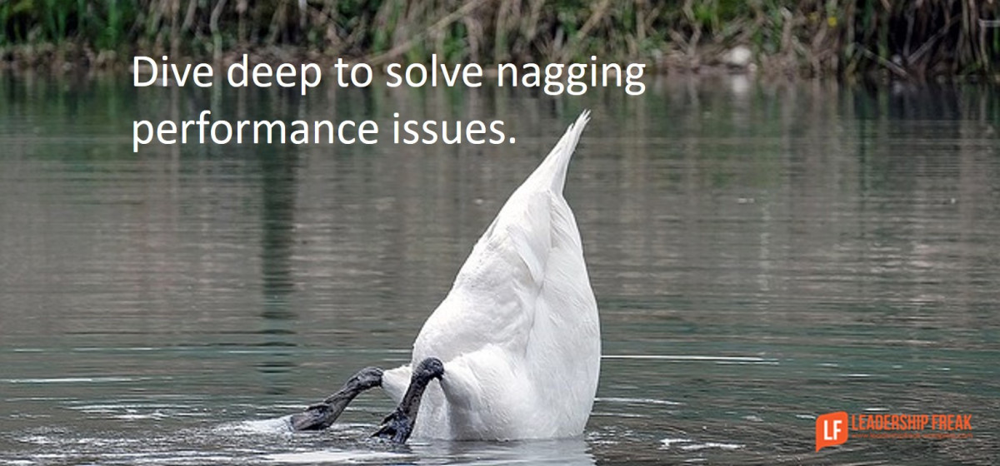
Impacts of Performance Problems
Direct and indirect costs
Reputational cost
Impact on quality of work and services
Impact on morale of high performing employees
May get worse over time if not handled promptly.

Slide 4
Documentation

Slide 5
Why Its Important
Establishes a record of employment actions taken and the reasons for the actions. Memories fail, managers move on and other circumstances change.
Informs employees of what is expected of them and the consequences if they do not meet expectations. Employees should never be surprised when they are in a termination meeting.
From a performance management standpoint, it serves as a written record to guide both the employer’s and the employee’s future behavior. It gives the employee the opportunity to improve.
Serves as evidence of the employer’s business reasons for actions taken, in the event an employee takes formal or informal steps with a claim against a manager or employer.
Brings about fair and equitable treatment. No one wants to be blindsided or treated differently than other employees.

Slide 6
Type of Documentation
Handwritten or typed notes from coaching and counseling sessions with employees.
Follow-up email summarizing a performance discussion meeting.
Written comments including specific examples in performance reviews.
Disciplinary actions, such as warning documents with specific examples and consequences.
Explanations with business reasons for employment actions such as demotions and promotions.

Slide 7
Effective Documentation Includes
The employer’s expectation.
How the employee has failed to meet that expectation.
Prior counseling or discipline.
The employer’s expectations for the employee going forward.
The consequences of the employee’s failure to make the requisite improvement.

Slide 8
Common disciplinary documentation mistakes include:
Using labels without providing behavioral examples.
Using words that sound like “proxies” for bias or retaliation.
Focusing on the employee’s intent (as opposed to results).
Focusing on the perceived cause of a performance problem as opposed to the problem itself.
Using absolutes that are not credible.
Including everything an employee has ever done wrong/overkill.
Using technical rather than plain language.
Failing to make clear the consequences of lack of improvement.

Slide 9
Implications For Not Documenting
Performance or attendance does not improve, and there are negative impacts to work, morale, and eventually the manager’s own performance.
Increased frustration by manager and co-workers.
Misunderstandings on interpretation of discussion.
Employees not equitably treated; may have discrimination claims.
Employees not treated fairly; may have wrongful termination claims.
Lack of documented formal evidence for defense in the event of legal claims.

Slide 10
Feedback

Slide 11

Informal Feedback
Do you have regular check ins?
Give and receive frequent feedback
Emphasize importance of changing the behavior. Help them to own responsibility for their part in the problem and the solution.
Consider creating a goal for measurable improvement i.e. Set a follow up meeting to check in on progress
Keep notes about your conversation

Slide 12

Research and Prepare
What are the specific behaviors that are problematic?
What positive behaviors would you like to see in the future?
What are the impacts? How do you notice them? Can they be measured?
How frequent and sustained are the behaviors?
What do you NOT know about this situation? How can you find out?

Slide 13

A More Formal Conversation
Schedule a private conversation
Factually describe the problem behaviors and their impact/s
Start with open-ended questions:
“What’s going on?” “How do you see it?” “Is there something I should know?”

Slide 14

When Providing Feedback
Describe unsatisfactory performance/behavior
Cite specific observed examples: past incidents, inability to meet goals, impact on employee, team, customers, department, etc.
Solicit a constructive employee action plan to resolve or ameliorate the performance failures or behavioral issues
Review action plan and establish milestone date(s) to review progress

Slide 15
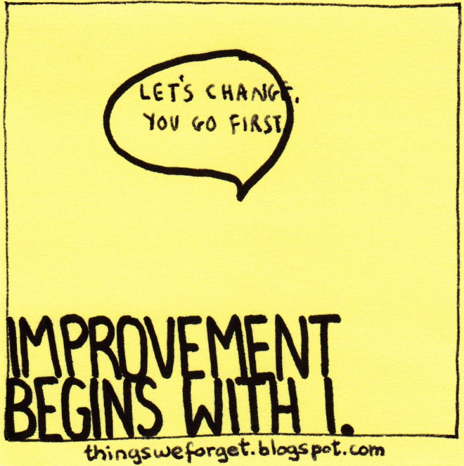
Follow Up Meeting
Acknowledge improvement, show appreciation
If there’s not:
Draft a written warning and ask HR to review
The written warning should include:
  history so far,
  measurable expected progress,
  date for follow up,
  consequences for not improving
A written warning can also be a summary of your coaching conversation

Slide 16
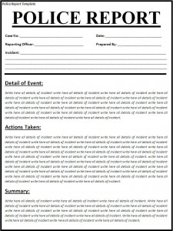
Formal Written Warnings
Draft and send to HR (Danielle or Tammi) for approval before giving to employee
Write in factual, non-pejorative language. Describe behaviors, don’t label the person.
Ongoing concerns may be accompanied by a Performance Improvement Plan
Copy will be put into personnel file

Slide 17
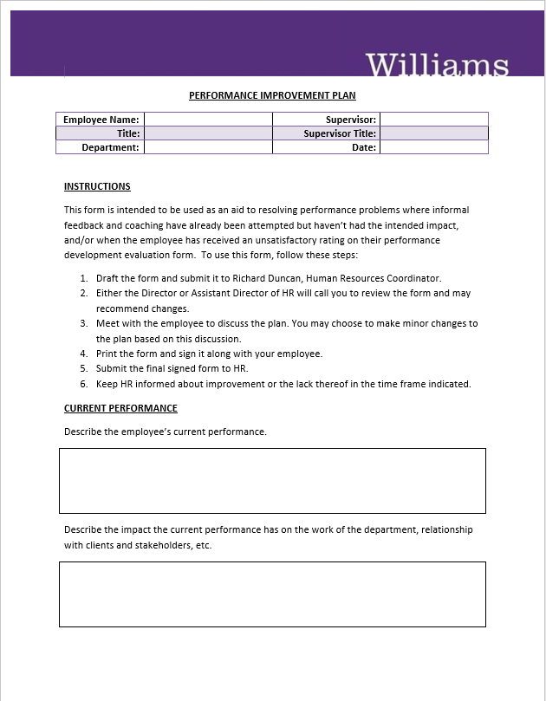
Performance Improvement Plans
Provide a thorough, detailed plan for needed improvement
Lays out consequences for lack of improvement
Review with HR (Danielle or Tammi) before giving to employee.

Slide 18

Final Written Warning
If no progress after first written warning:
  Draft a final written warning
  Have it reviewed by HR
  Meet with employee to review lack of progress
  Give final written warning to employee

Slide 19

Discharge
Ask yourself, will this be a surprise to the employee?
Have you made performance expectations clear?
Have you given the individual the opportunity to correct the behavior?
If no progress after final written warning, consult with HR for advice on termination procedures.

Slide 20
If Employee Mentions Other Personal Problems
Many performance problems can be an indirect result of employee personal problems.
Refer employee to the Employee Assistance Program
Notes:
The Management Resource Consultation (MRC) line is a dedicated number, staffed by senior clinical consultants who are specifically equipped to provide high level consultation and response around critical incidents, performance issues, and sensitive or high risk cases.

Slide 21
Dealing with Performance Problems Process Overview
Offer FMLA
FMLA Approved
Track FMLA covered absences
Yes
Research
Conversation
Mentions Illness?
Mentions Personal Problems?
Refer to EAP
No
Yes
No
Set expectations and time to check on progress
Progress?
Progress?
Progress?
No
1st Written Warning
No
2nd Written Warning
Yes
No
Yes
Show appreciation
Yes
Termination

Slide 22
Key Take-A-Ways

Slide 23
Do’s and Don’ts
Do | Don’t
Check in when you see early signs | Ignore the signs and patterns
Describe behaviors | Label the person
Give praise to employees with great performance | Give feedback publically to employees on performance problems
Treat employees equitably with regard to performance | Single out employees for feedback on performance
Have the informal feedback discussion promptly | Wait for the performance review to give feedback
Manage performance and attendance | Let others think its okay to have chronic performance problems
Refer employees liberally to HR, EAP, OIDE | Don’t feel alone in managing these issues

Slide 24

One Size Does Not Fit All
Each employee and their situation is unique
Consult with other managers in your area to see how they have handled similar cases
Contact HR

Slide 25
Summary
Documentation is important for both the employer and the employee.
Good documentation answers the questions who, what, where, and when.
Document early. Do not wait.
Discussion without documentation equals misunderstandings.
Discuss and document only the facts.
Give specific examples for how the employee is not meeting expectations and specific guidance for how the employee can improve.

Slide 26
At the heart of a positive employee relations strategy, its about managing relationships and communicating effectively.

